Slide 1
HTTP

Slide 2
HTTP
a protocol on top of TCP
spec
http://www.w3.org/Protocols/rfc2616/rfc2616.txt

Slide 3
servers receive requests
and send back responses

Slide 4
servers receive requests
and send back responses
Remember
it’s this simple

Slide 5
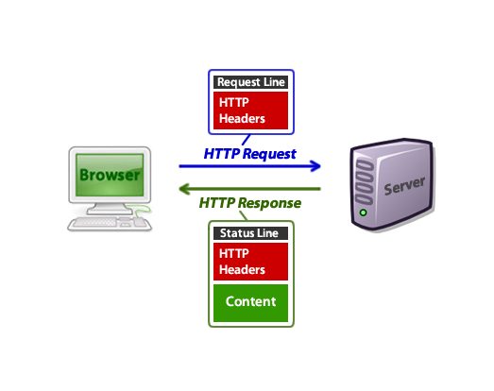

Slide 6
HTTP Verbs / Methods
GET
POST
PUT
DELETE
HEAD
read more on wikipedia

Slide 7
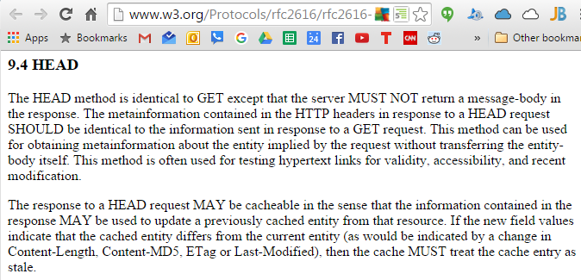
GET
POST
PUT
DELETE
HEAD

Slide 8
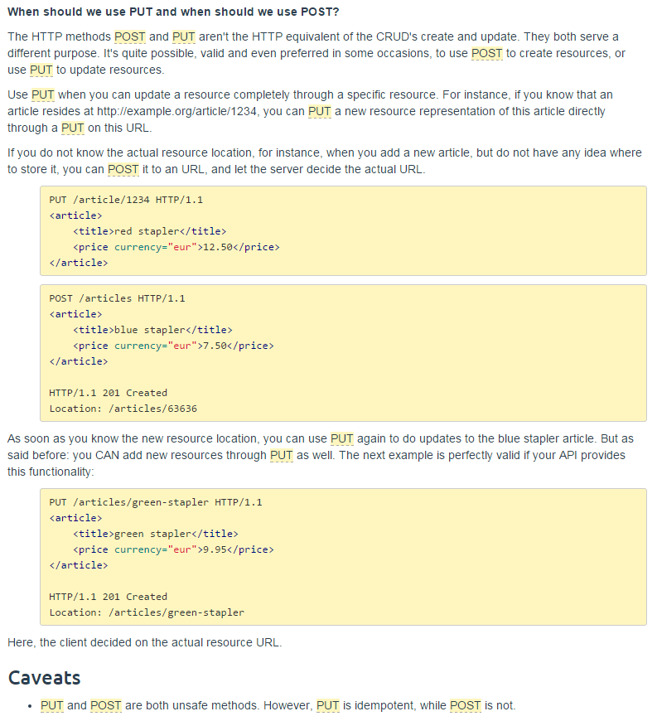
GET
POST
PUT
DELETE
HEAD
http://restcookbook.com/HTTP%20Methods/put-vs-post/

Slide 9
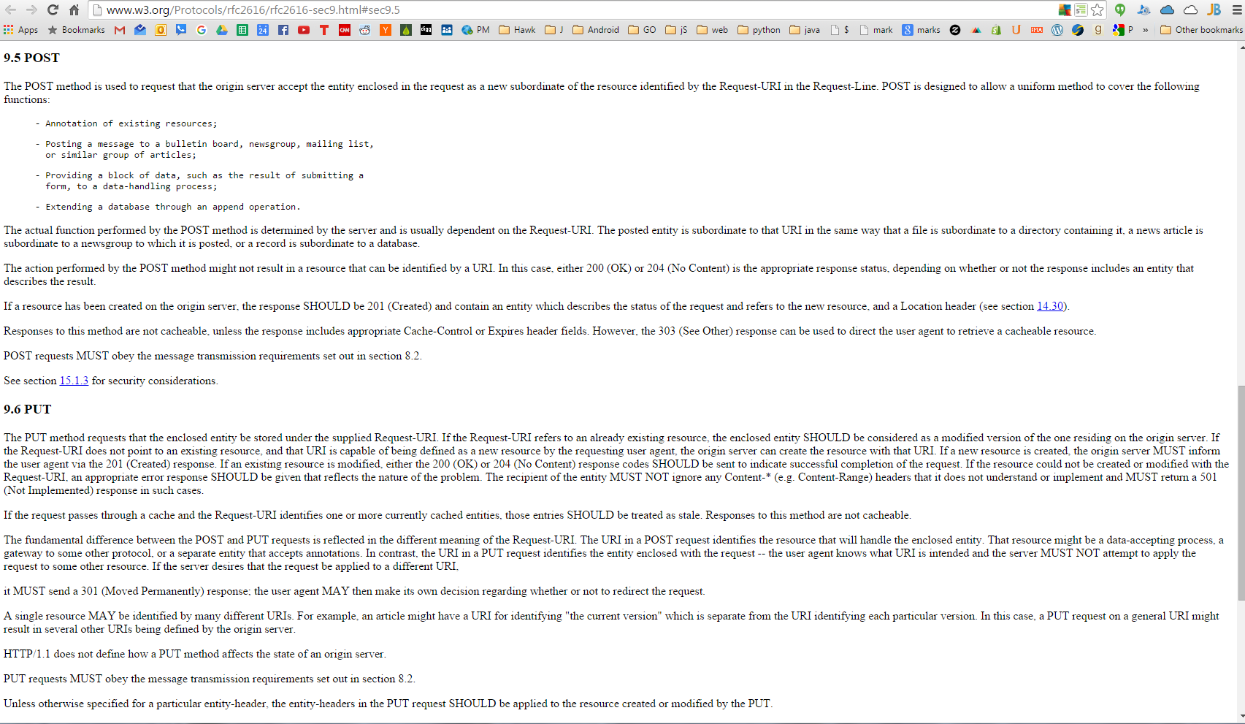

Slide 10
HTTP Headers
Accept
Connection
Content-Type
Location
Range
Referer
Transfer-Encoding
WWW-Authenticate
read more on wikipedia
Read more here too
request and response will both have headers

Slide 11
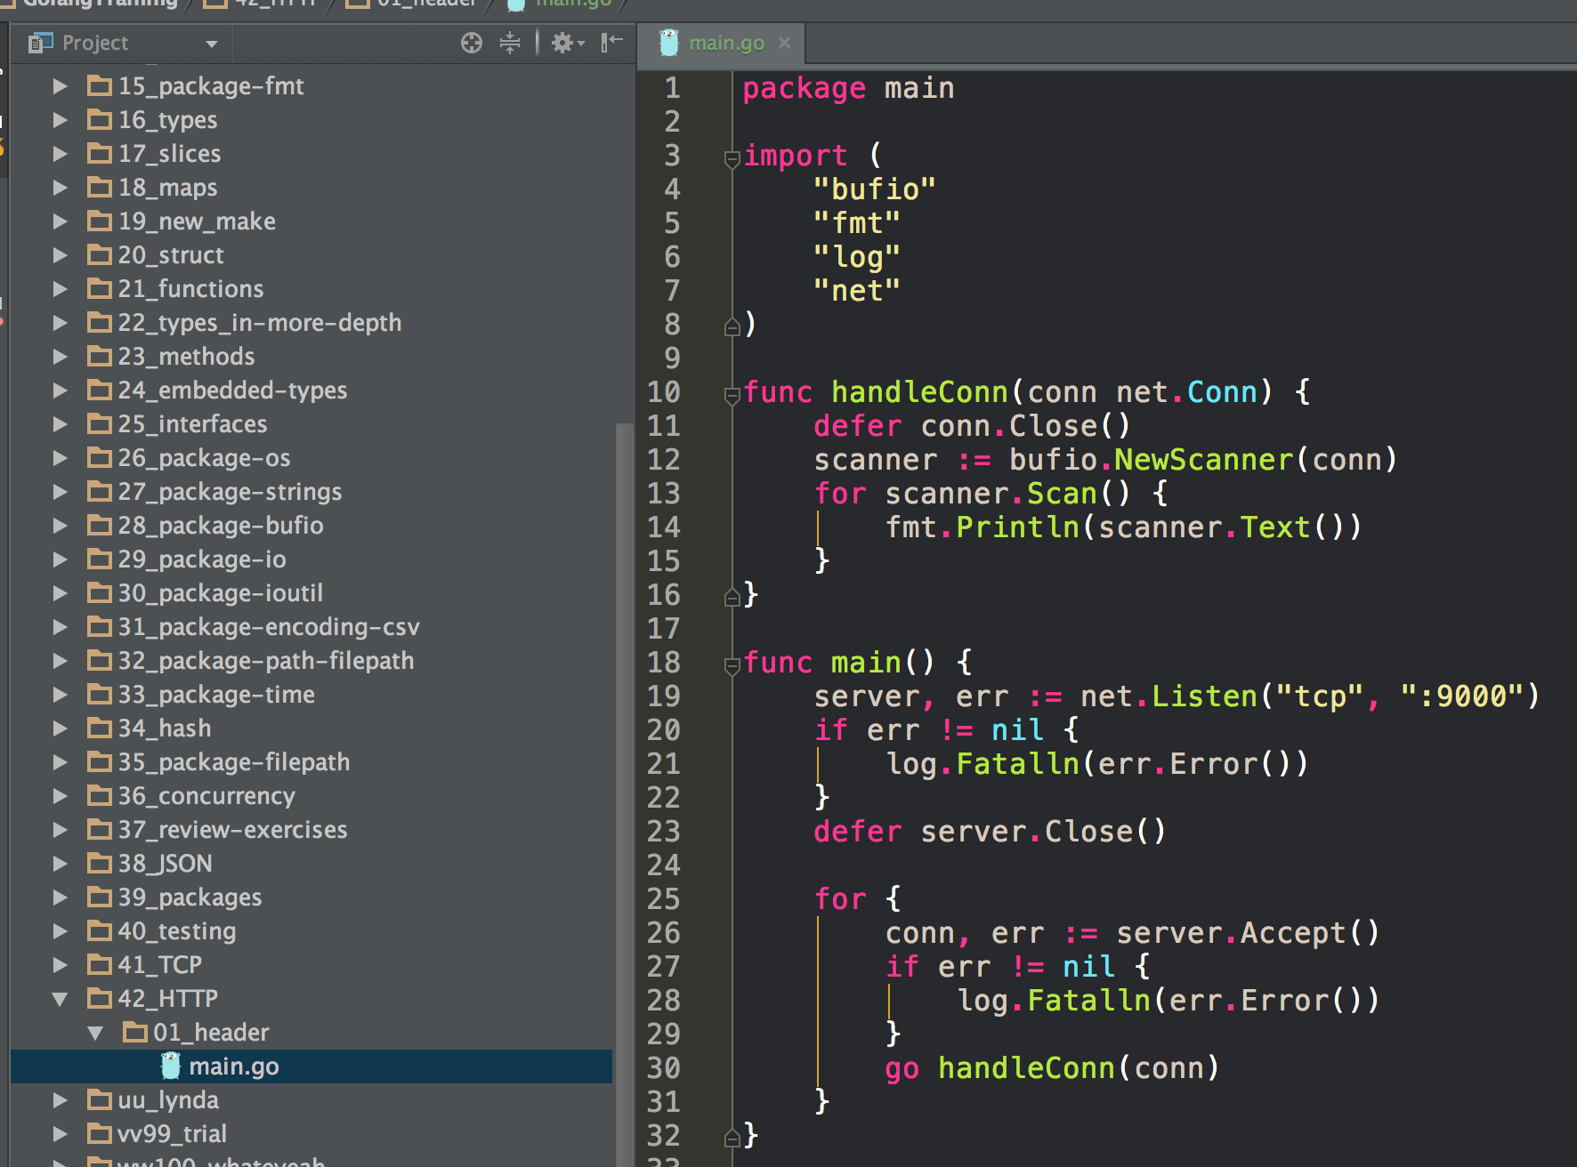
what does this code do? Is it familiar?

Slide 12
access localhost:9000 from a browser
(as opposed to TCP telnet like previous lecture last week)
we can speak HTTP
in our TCP server

Slide 13
request header

Slide 14

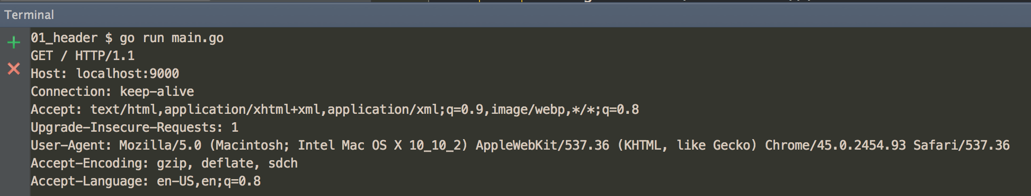
GET request
URL
HTTP Protocol Version

Slide 16
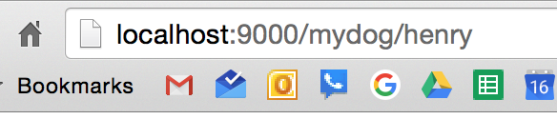
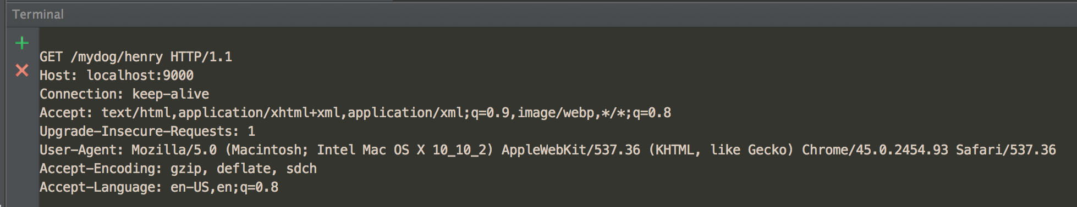
GET request
URL
HTTP Protocol Version

Slide 17
GET request
URL
HTTP Protocol Version
headers
key: value

Slide 18
Request = Request-Line *(header CRLF) CRLF [ message-body ] Request-Line = Method Request-URI HTTP-Version CRLF Header = Name: Value

Slide 19
Request = Request-Line *(header CRLF) CRLF [ message-body ] Request-Line = Method Request-URI HTTP-Version CRLF Header = Name: Value
GET - no message-body
POST - message-body

Slide 20
response header

Slide 21
Response = Status-Line *(header CRLF) CRLF [ message-body ] Status-Line = HTTP-Version Status-Code Reason-Phrase CRLF

Slide 22
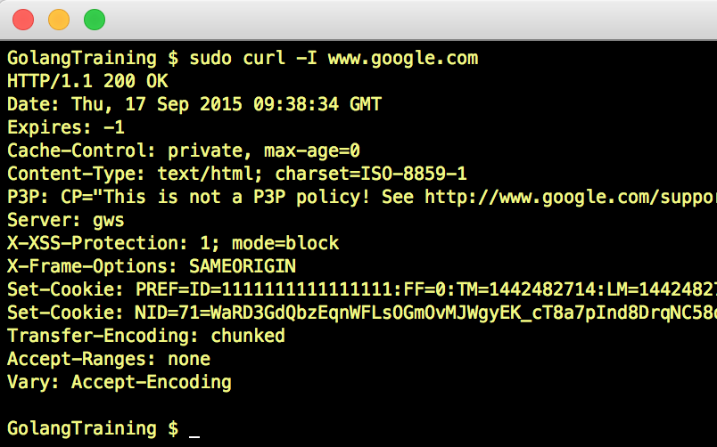

Slide 24
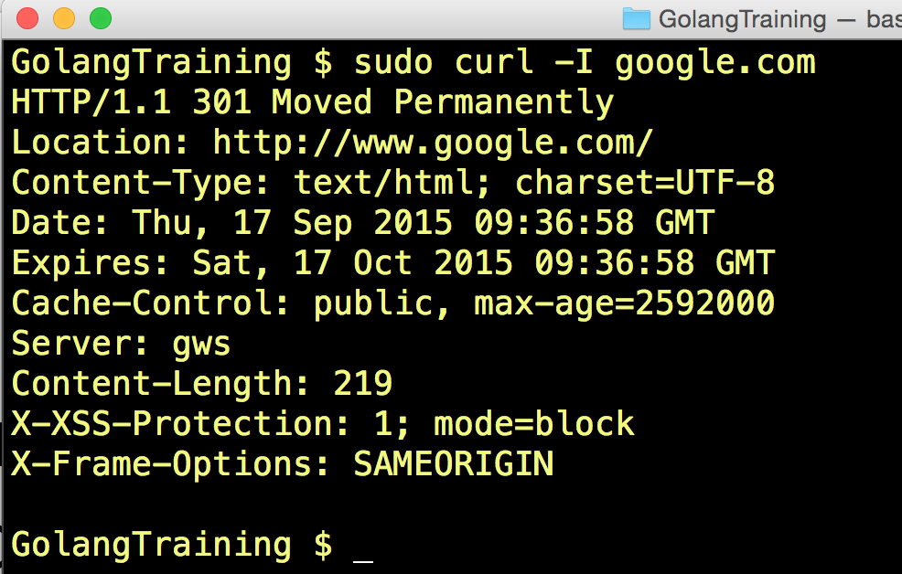

Slide 25
To make an HTTP server
parse the request
serve the response

Slide 26
HTTP server from scratch

Slide 27
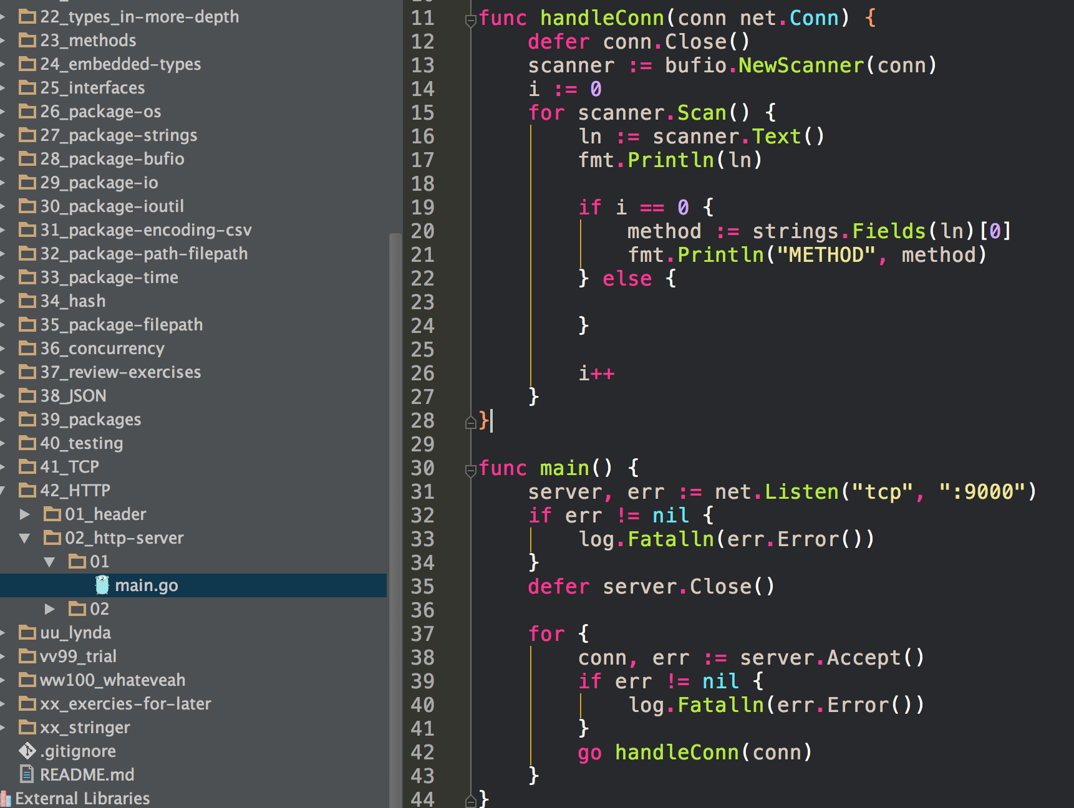
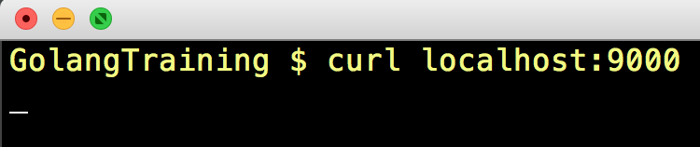
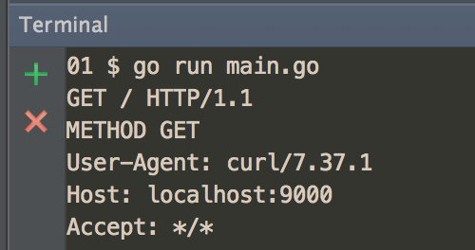

Slide 28
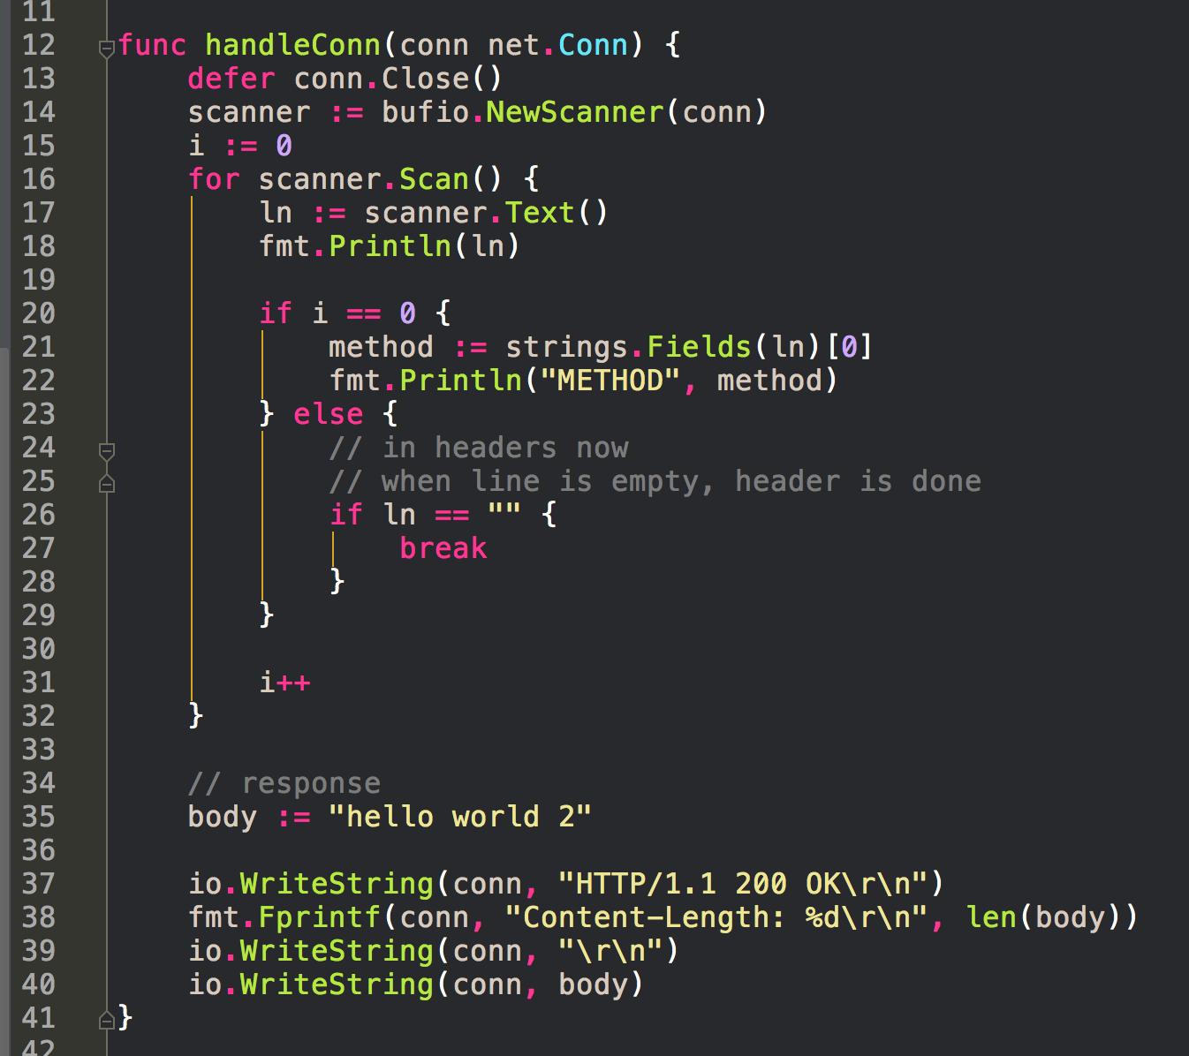
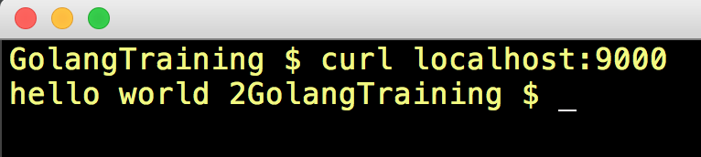
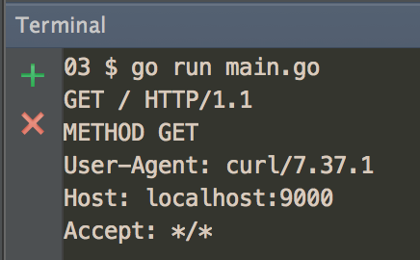
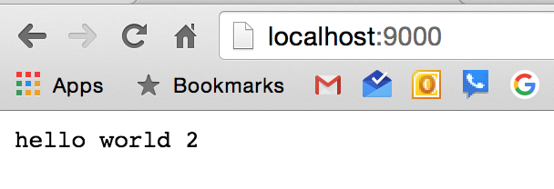
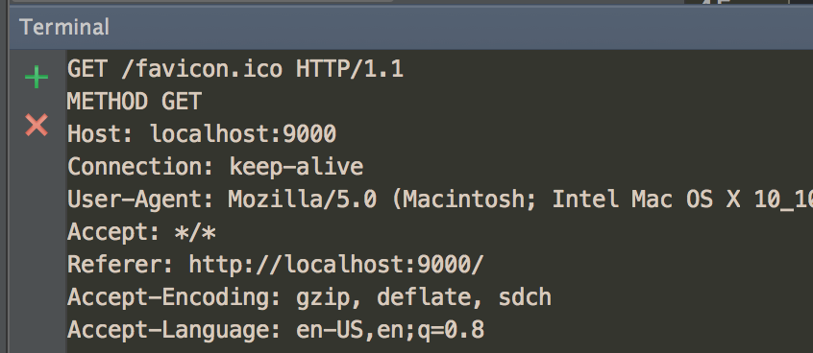

Slide 29
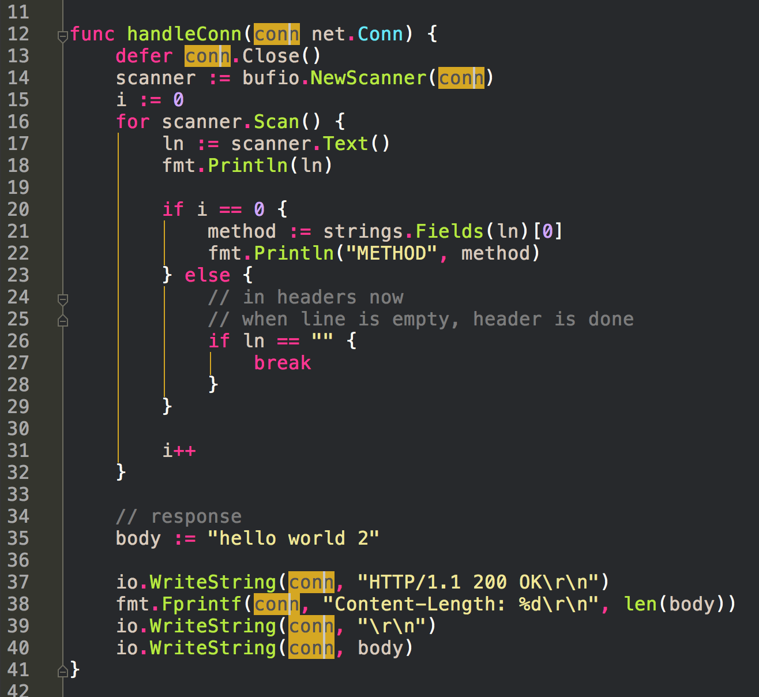
conn is a
reader & writer

Slide 30
you can keep building from scratch

Slide 31
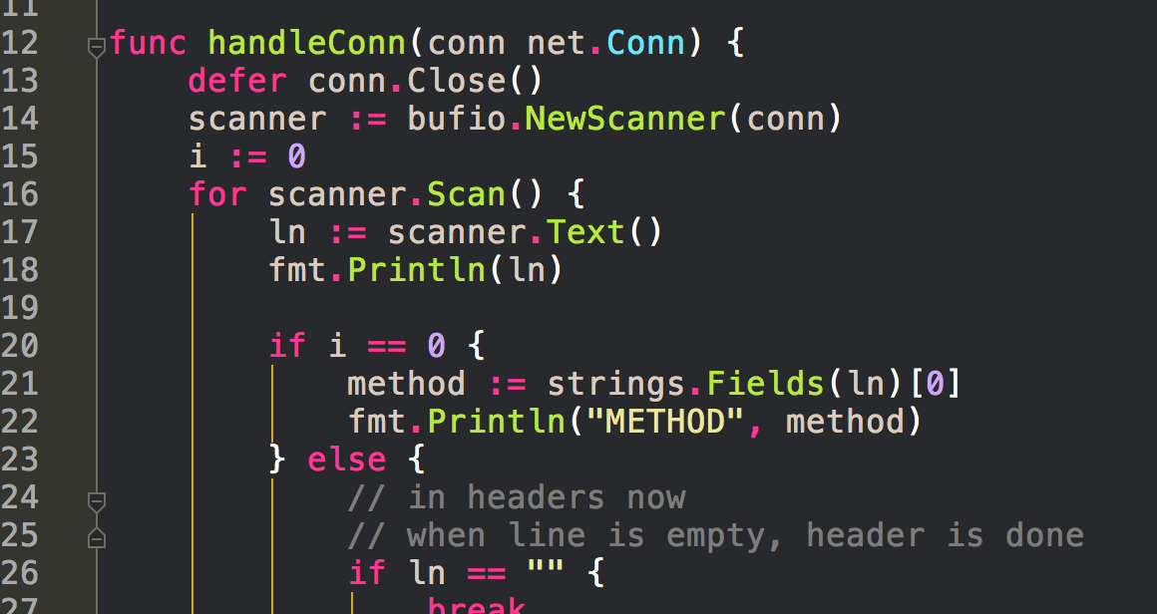
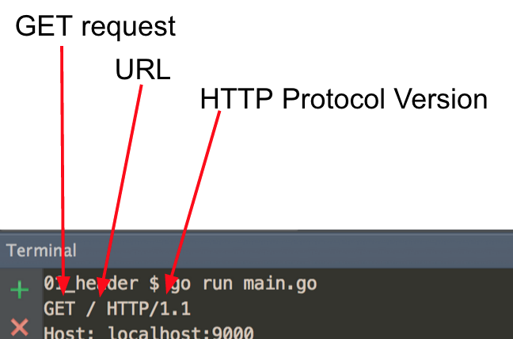

Slide 32
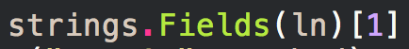
We could then start doing request routing based on the URL

Slide 33
The main point here - to make an HTTP server
parse the request
serve the response

Slide 34
exercise
Create a TCP server which can handle a simple HTTP request and return the URL that was passed into it

Slide 35
HTTP Headers

Slide 36
HTTP Headers
Accept
Connection
Content-Type
application/x-www-form-urlencoded
multipart/form-data
text/plain
text/html
Location
Range
Referer
Transfer-Encoding
WWW-Authenticate
read more on wikipedia
Read more here too

Slide 37
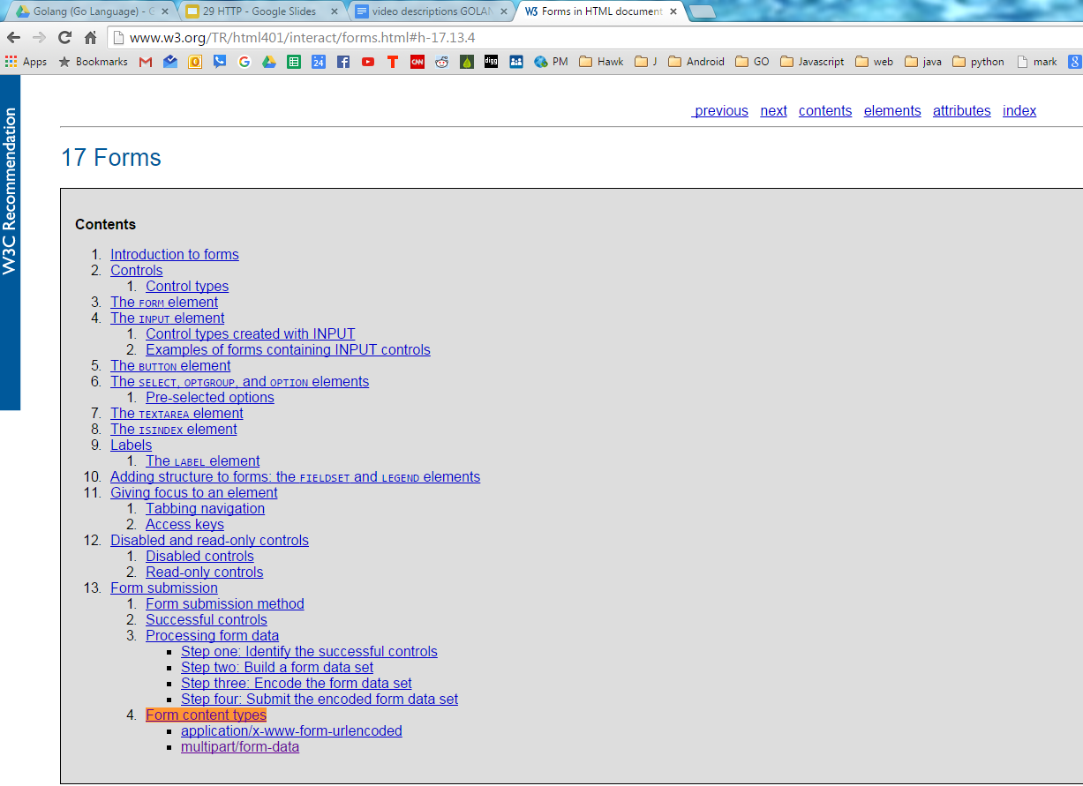

Slide 38
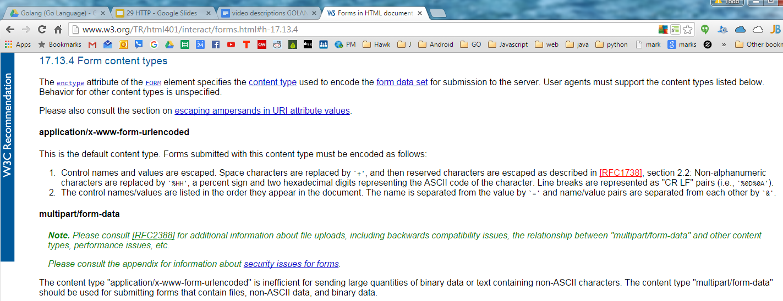

Slide 39
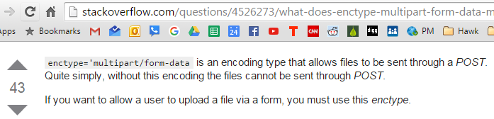
HTTP Verbs
GET
POST
PUT
DELETE
HEAD
read more on wikipedia

Slide 40
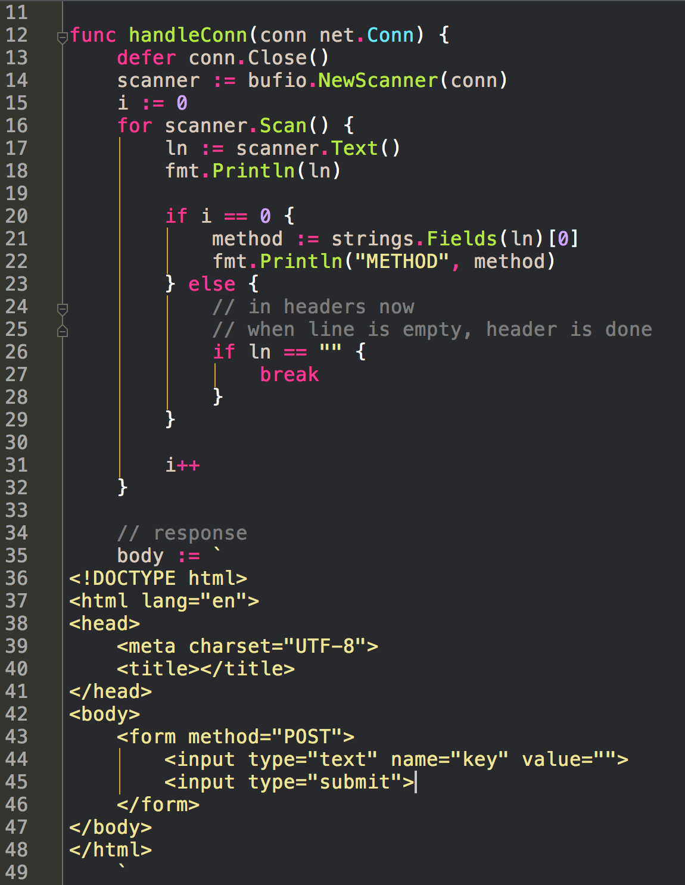
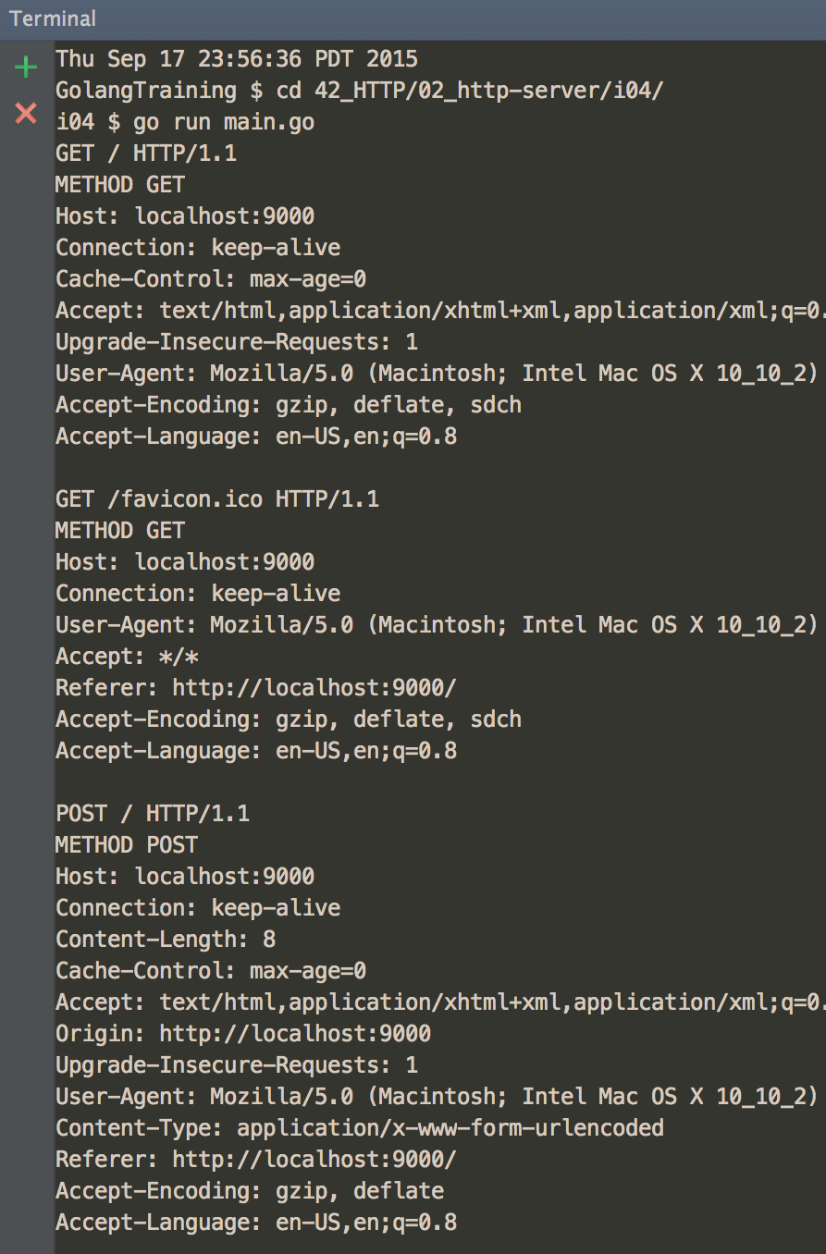
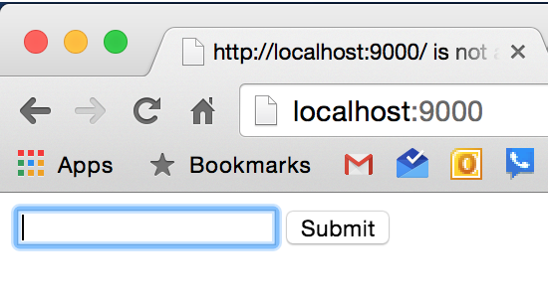
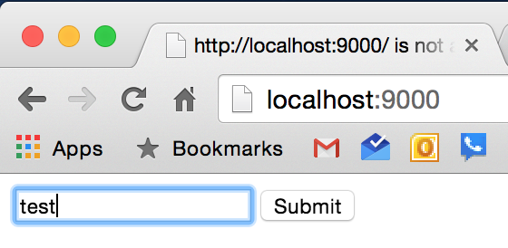

Slide 41
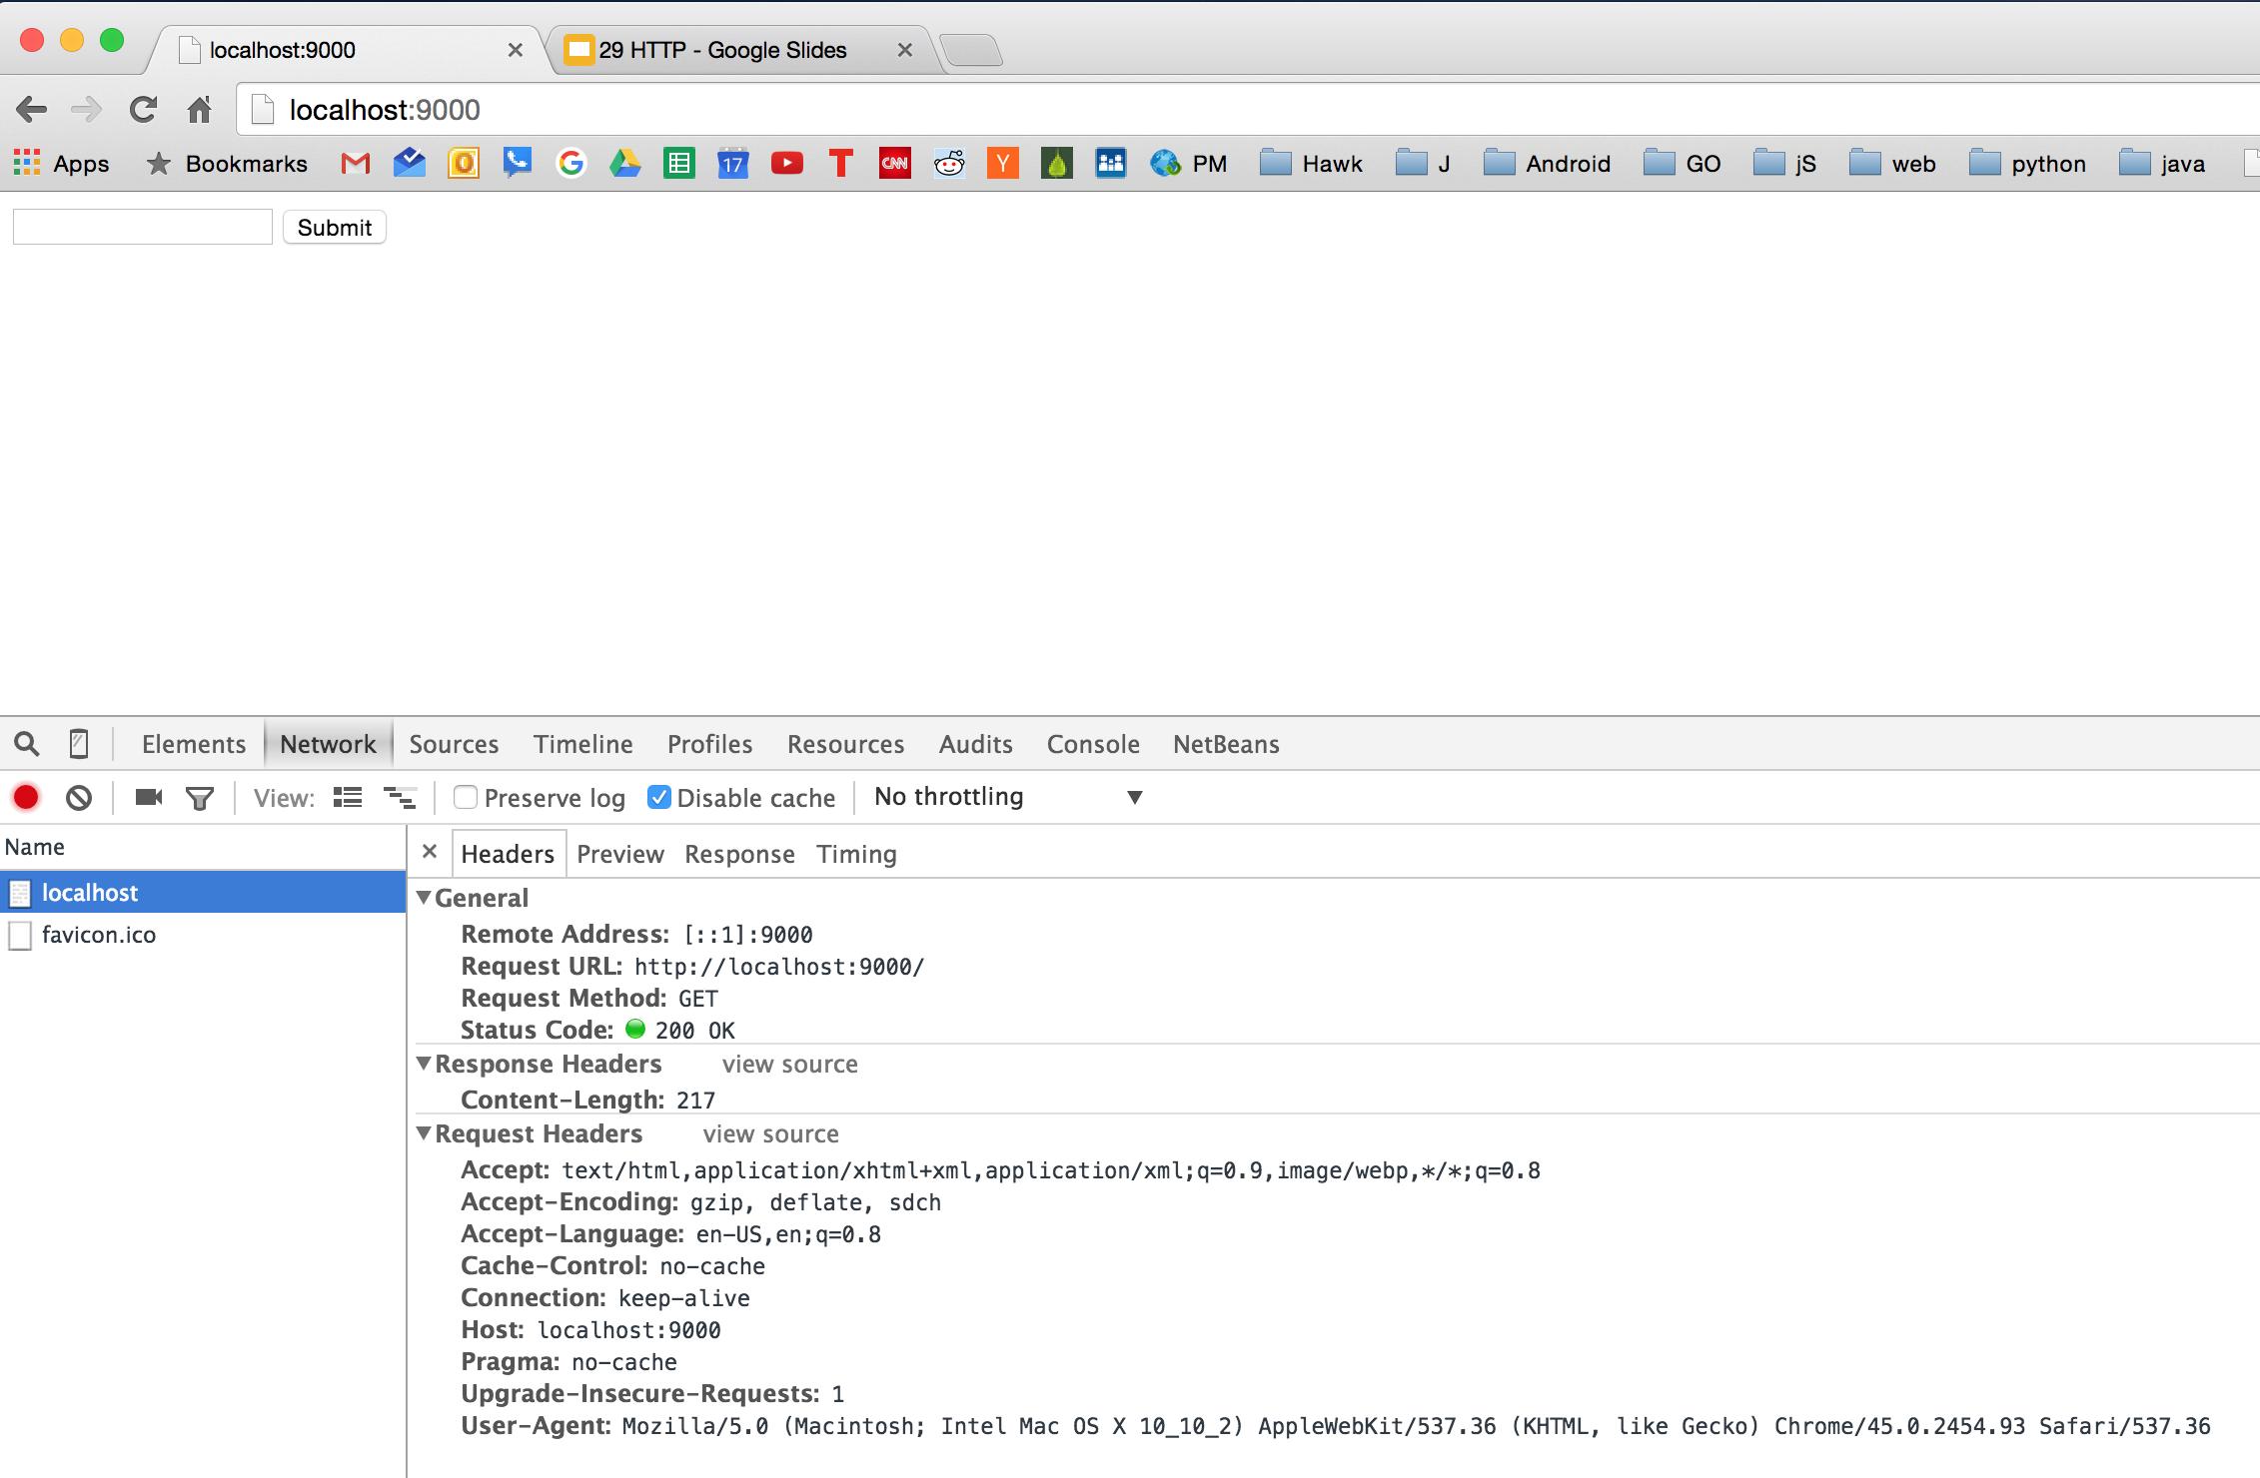

Slide 42
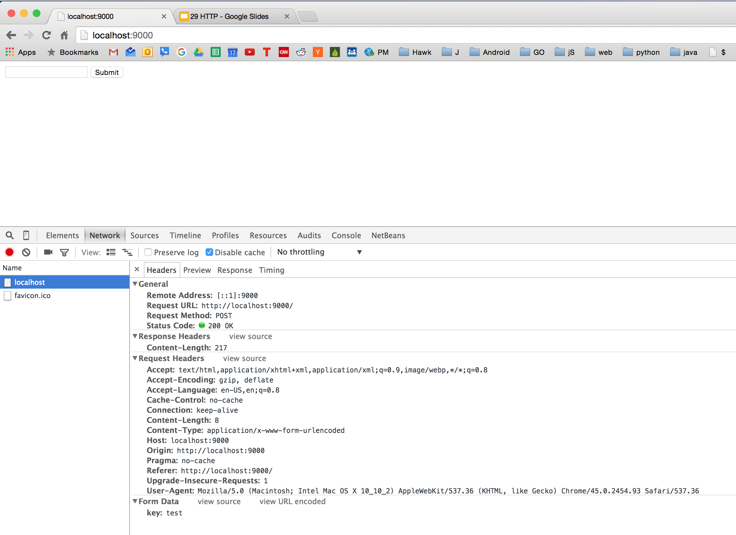

Slide 43
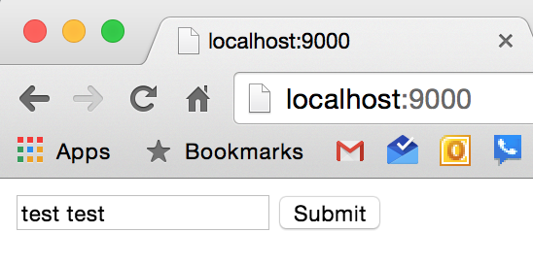
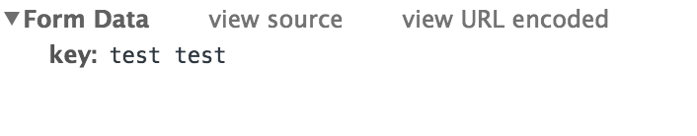
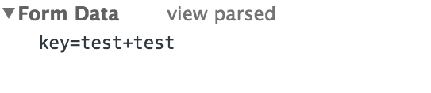

Slide 44
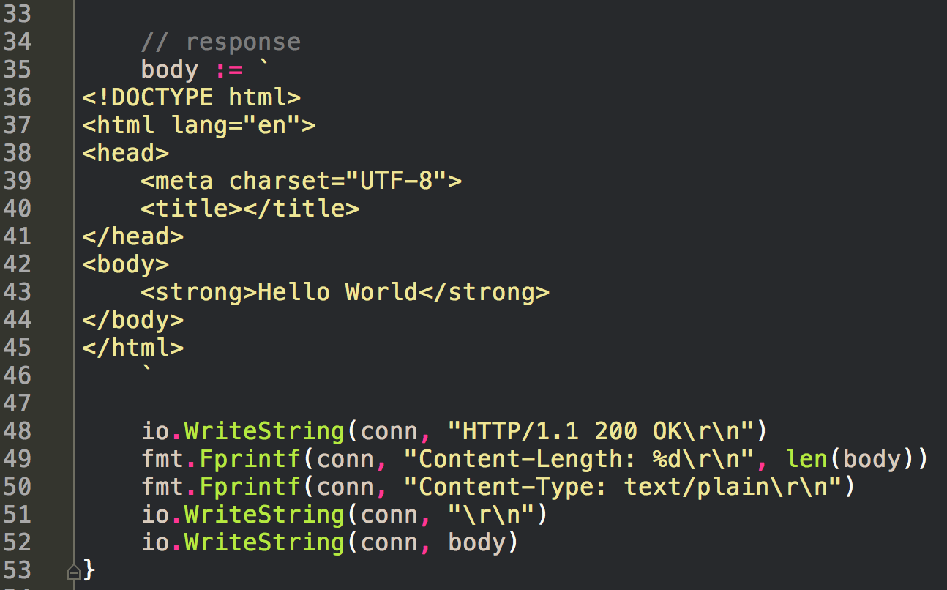
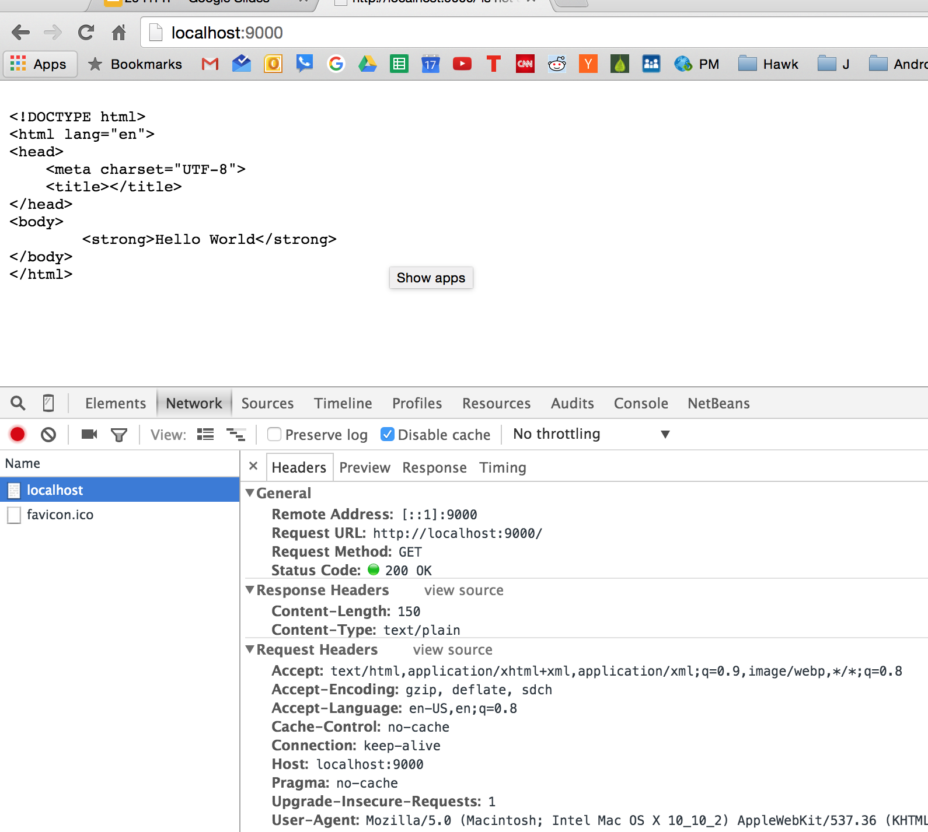

Slide 45
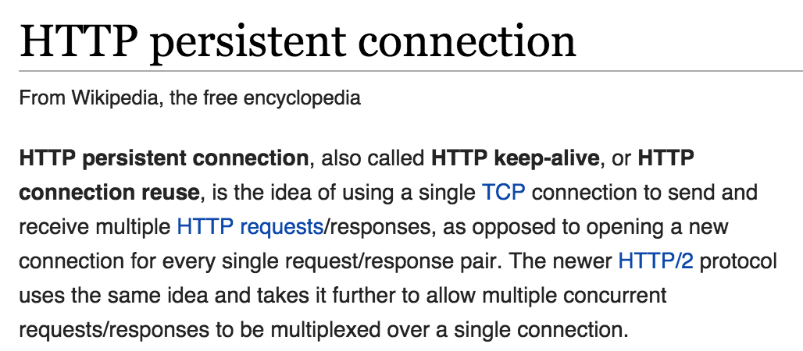
HTTP Headers
Accept
Connection
keep alive
needs content length
otherwise doesn’t know when request ends
closed
Content-Type
application/x-www-form-urlencoded
multipart/form-data
text/plain
Location
Range
Referer
Transfer-Encoding
WWW-Authenticate
read more on wikipedia
Read more here too

Slide 46
HTTP Headers
Accept
Connection
keep alive
needs content length
otherwise doesn’t know when request ends
closed
Content-Type
application/x-www-form-urlencoded
multipart/form-data
text/plain
Location
used for redirects
Range
Referer
Transfer-Encoding
WWW-Authenticate

Slide 47
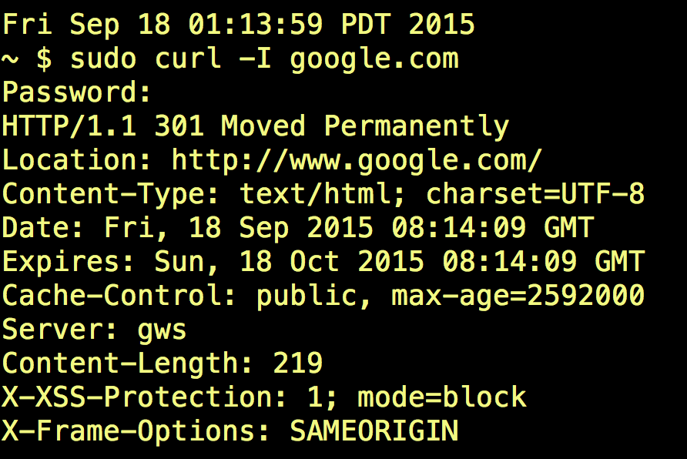

Slide 48
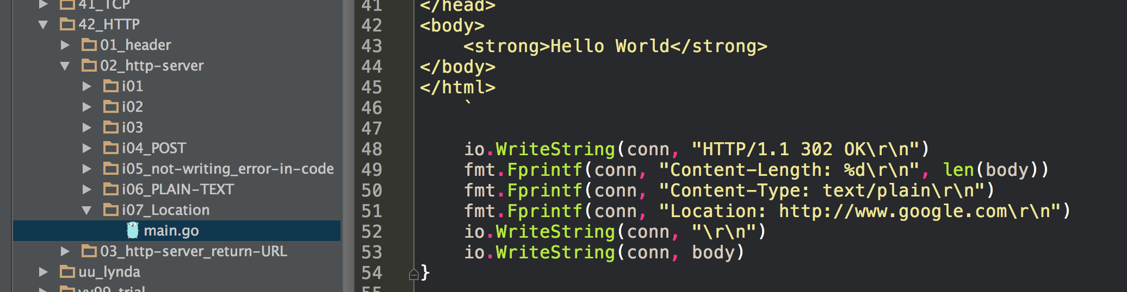
HTTP status codes

Slide 49
HTTP Headers
Accept
Connection
keep alive
needs content length
otherwise doesn’t know when request ends
closed
Content-Type
application/x-www-form-urlencoded
multipart/form-data
text/plain
Location
used for redirects
Range
for resuming download of files
Referer
Transfer-Encoding
WWW-Authenticate

Slide 50
HTTP Headers
Accept
Connection
keep alive
needs content length
otherwise doesn’t know when request ends
closed
Content-Type
application/x-www-form-urlencoded
multipart/form-data
text/plain
Location
used for redirects
Range
for resuming download of files
Referer
misspelled in the spec
so you have to use it that way
use it to see where a client came from
not trustworthy b/c anyone can change it
Transfer-Encoding
WWW-Authenticate

Slide 51
HTTP Headers
Accept
Connection
keep alive
needs content length
otherwise doesn’t know when request ends
closed
Content-Type
application/x-www-form-urlencoded
multipart/form-data
text/plain
Location
used for redirects
Range
for resuming download of files
Referer
misspelled in the spec
so you have to use it that way
use it to see where a client came from
not trustworthy b/c anyone can change it
Transfer-Encoding
WWW-Authenticate
basic access authentication
wikipedia
not secure; shouldn’t use

Slide 52
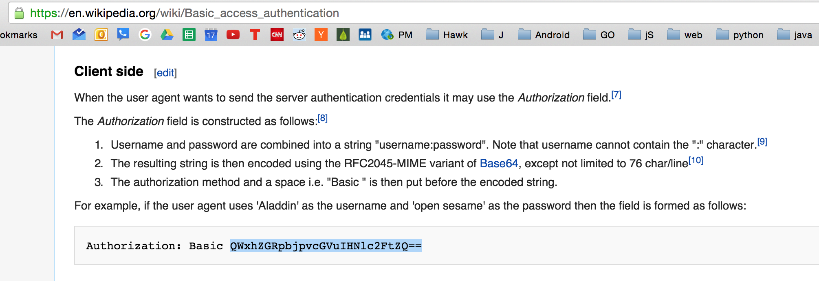
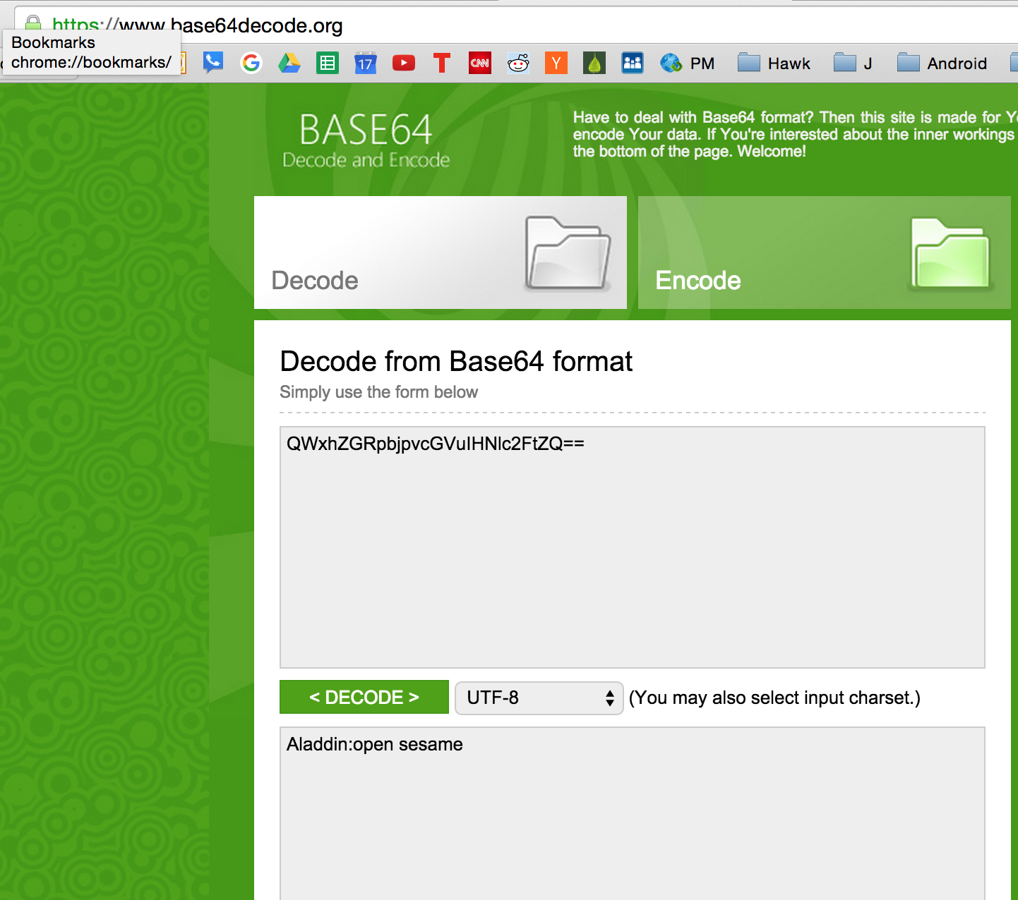

Slide 53
caching

Slide 54
much to know

